Slide 1
Dr Steve Kell Larwood Health Partnership
Primary Care Home – making change happen

Slide 3
Larwood
5 sites, based in Worksop, North Nottinghamshire
32,000 patients
16 Partners, 3 salaried GPs, 3 Nurse Practitioners
High levels of health need, social isolation, substance misuse, smoking, obesity.
Urgent care demand high
Significant experience – commissioning and provision
RCGP Quality Practice Award
Outstanding CQC rating

Slide 4
What is a Primary Care Home?
The PCH is a form of multispecialty community provider (MCP) model. Its key features are:
provision of care to a defined, registered population of between 30,000 and 50,000;
aligned clinical financial drivers through a unified, capitated budget with appropriate shared risks and rewards
an integrated workforce, with a strong focus on partnerships spanning primary, secondary and social care; and
a combined focus on personalisation of care with improvements in population health outcomes.

Slide 6
Culture
Most important step
Be clear – why?
Identify concerns and address first
Equal partnership
Staff workshops

Slide 7
Our Local Aims

Slide 8
Monthly Provider Board:
Larwood and Bawtry GPs
Bassetlaw Health Partnerships
Voluntary Sector
Notts Healthcare Trust
Doncaster and Bassetlaw NHS FT
Bassetlaw CCG
Social Care
Bassetlaw District Council

Slide 9
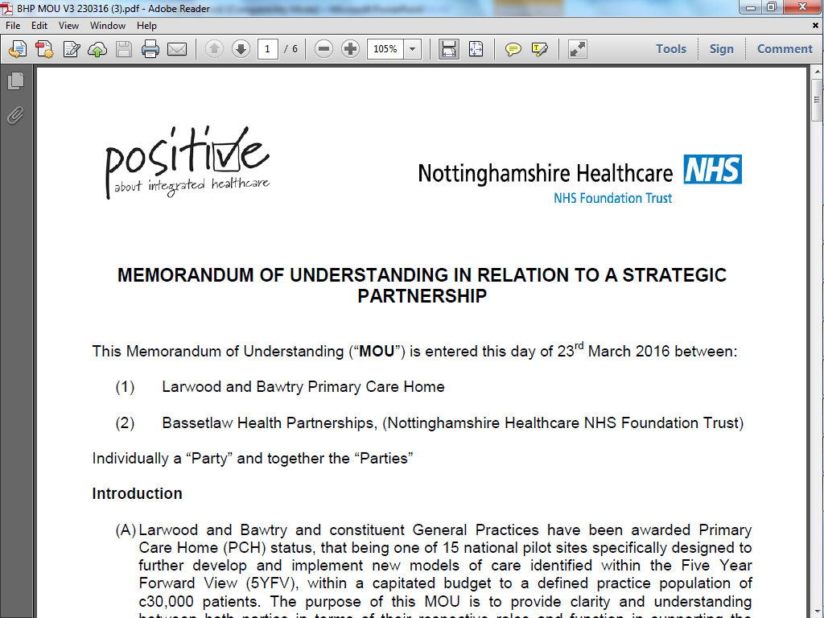

Slide 10
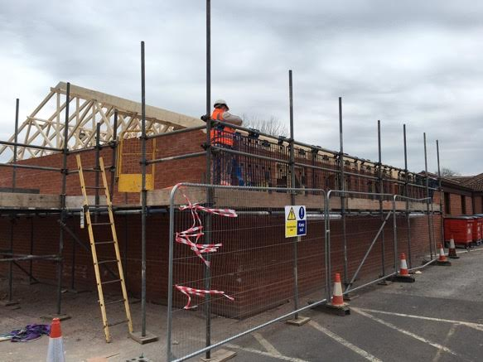

Slide 11
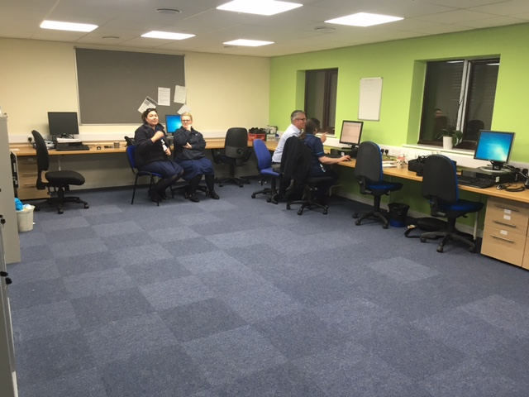

Slide 12
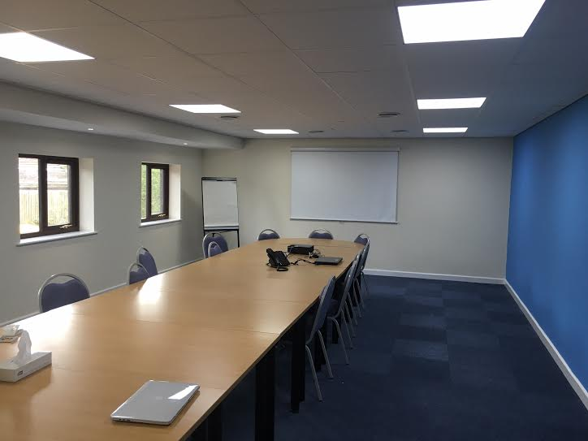

Slide 13
Staff Wellbeing
Designed by patients and staff
Nursing workshop
One team approach
Supportive, joint training.
Encourage skill mix and develop roles
Job satisfaction
Education – train at all levels, Advanced Training Practice.
Exercise classes
Reinforce – want to be the best employer we can.

Slide 14
Patient Outcomes
Practice pharmacist/Head of Prescribing
Utilise skill mix: e.g. Palliative care, diabetes, substance misuse team
Communication and early intervention
Reduced hand-offs
Care Homes
Social care
Voluntary sector input
Health Promotion

Slide 15
Efficiencies
Reduced bureaucracy and hand-offs
Look for win-wins
Reduced admissions
Better primary care access (urgent…)
Prescribing
Whole system view

Slide 16
Results
Staff Satisfaction | 82% of staff felt that PCH had improved their job satisfaction. The vacancy rate has risen as the practice now feels confident to hire. Hiring was frozen prior to PCH.
Staff Retention | 3 new GP partners recruited based on appeal of PCH ways of working. Pilot site feel confident to go out and hire again after a recruitment freeze.
Patient Experience | 91% of staff felt that PCH had improved patient experience.
Population Health | 73% of staff felt that PCH would help to improve population health and 91% felt it would help to improve clinical outcomes.

Slide 17
Results
For Larwood Health Partnership:
May-Dec 16/17 v 15/16
Outpatients: n=108 +£16,974
Emergency Admissions: n=121 -£263,930
Prescribing: -£193,017
Total: -£440,000

Slide 18
This Year
April –September 17
OP referrals Inc £65k
Prescribing Dec £38k
Em Admissions. Dec £290k
Total reduction £260k

Slide 19
Care Homes

Slide 21
Next Steps
Align Incentives
Physiotherapy
CAMHS
Care Home Project
Training hub
Mental health

Slide 22
Last 12 months:
2 Partners
3 Salaried GPs
3 pharmacists
2 paramedics
2 practice nurses

